Slide 1




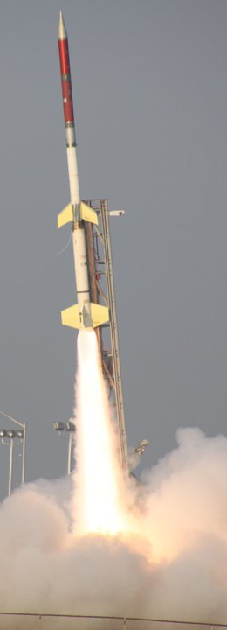

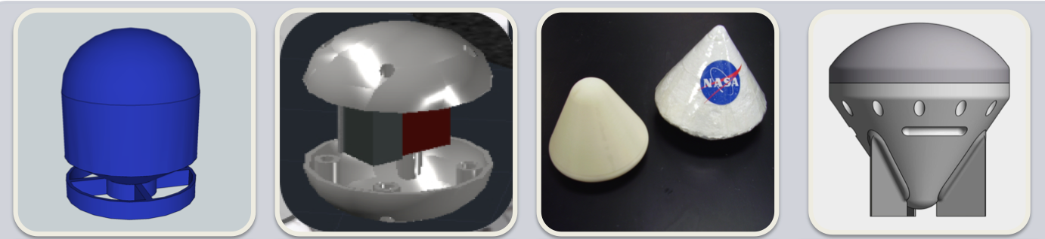
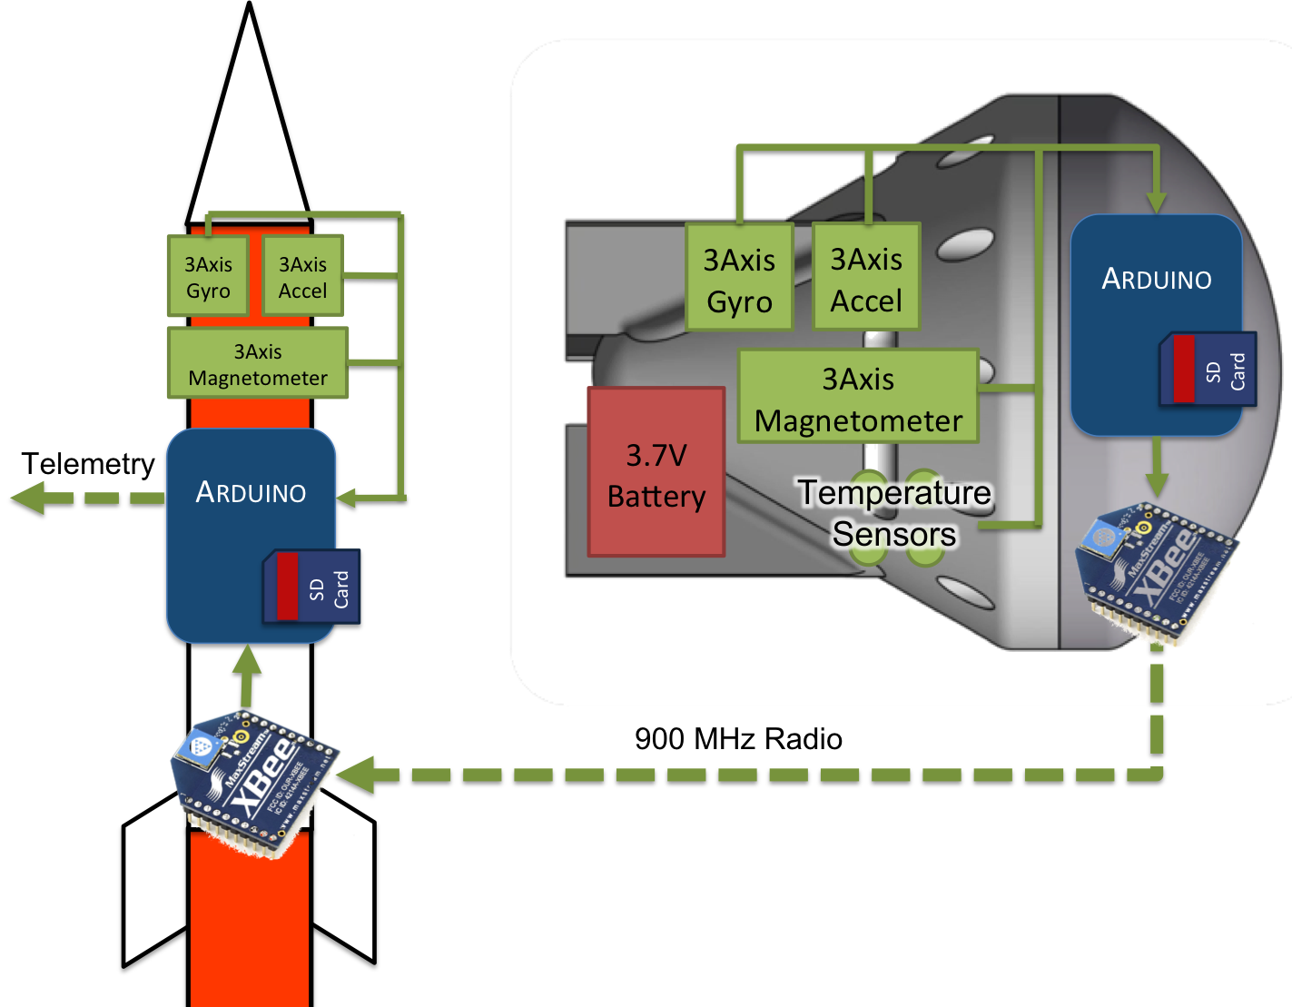

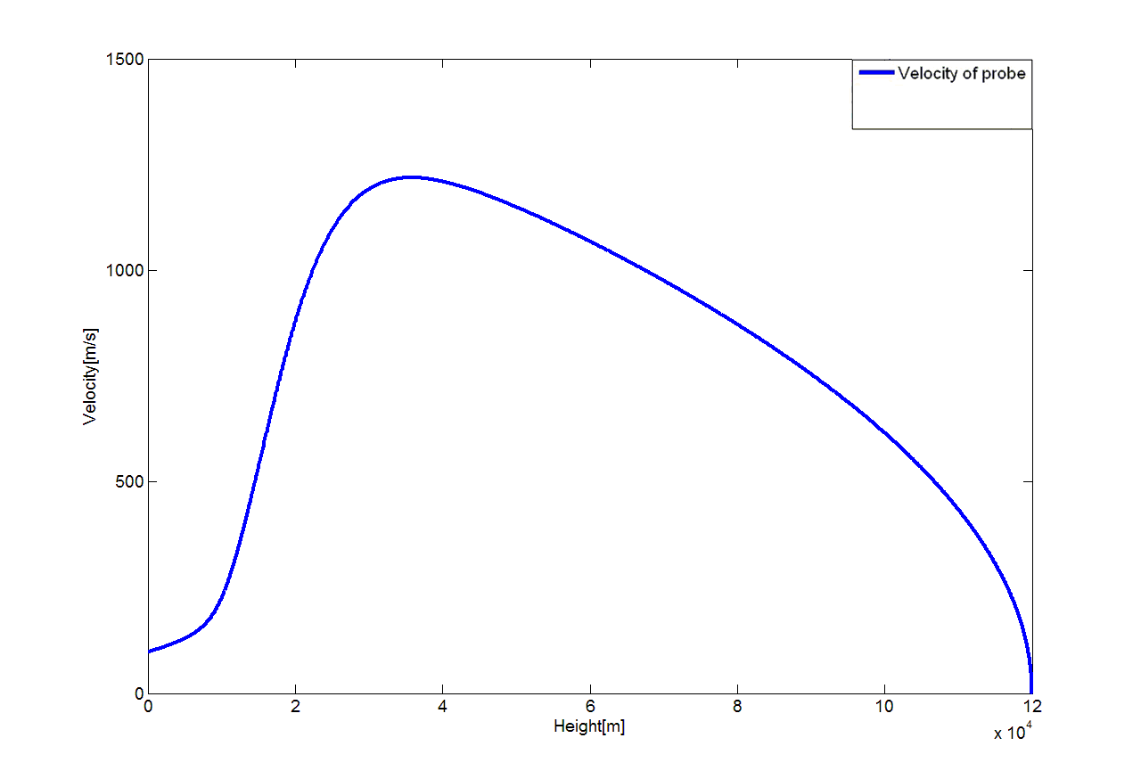
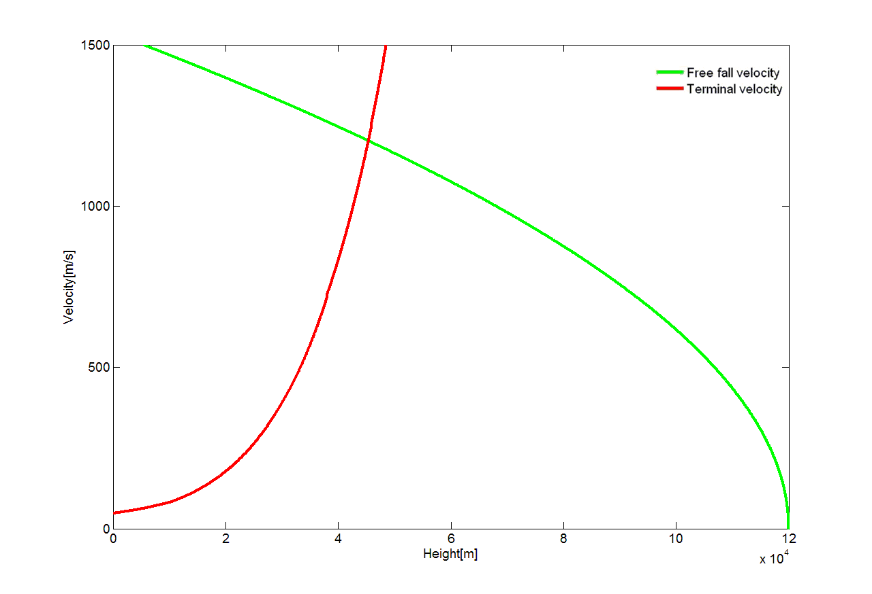
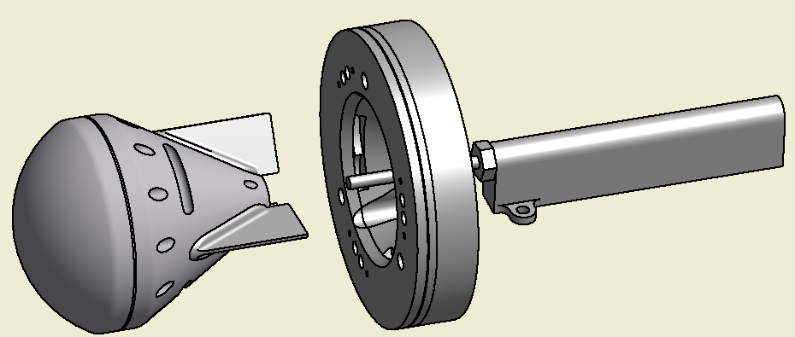
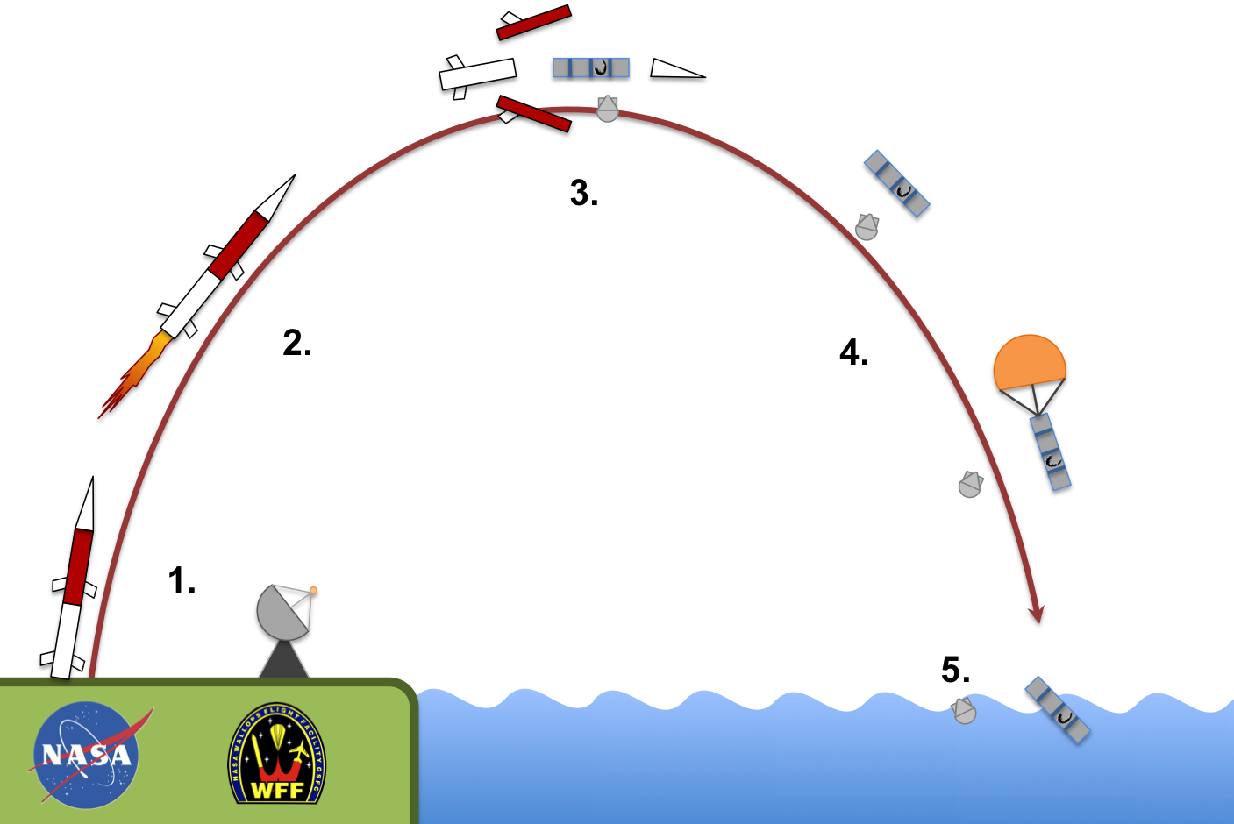
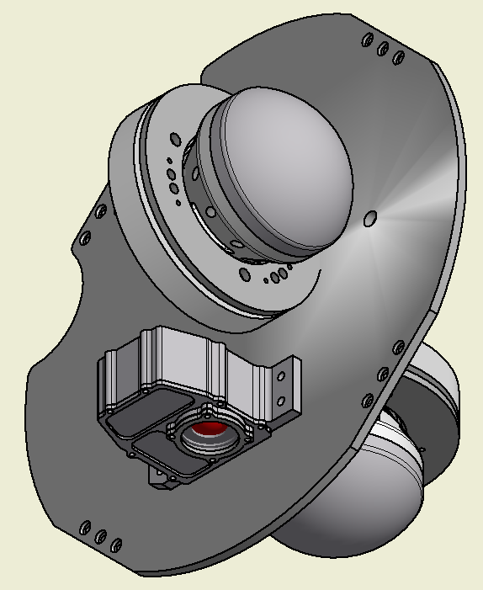
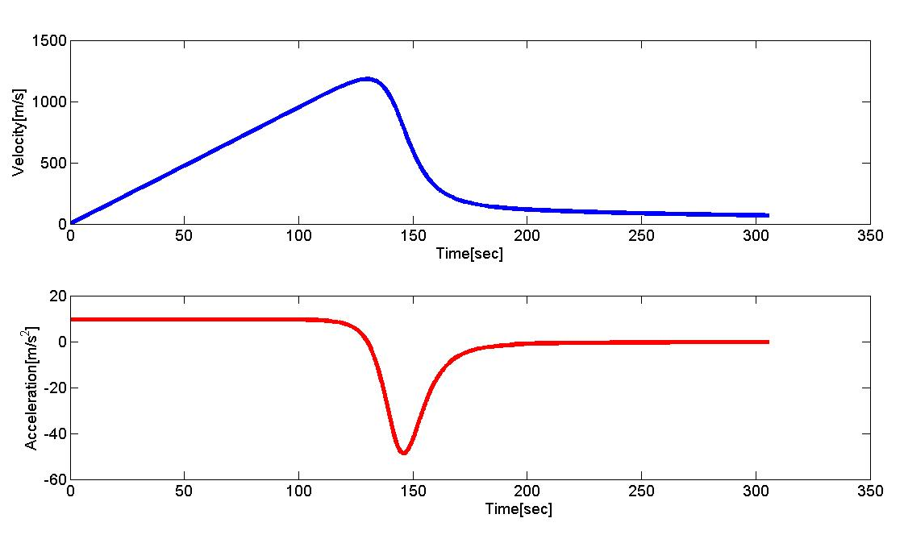
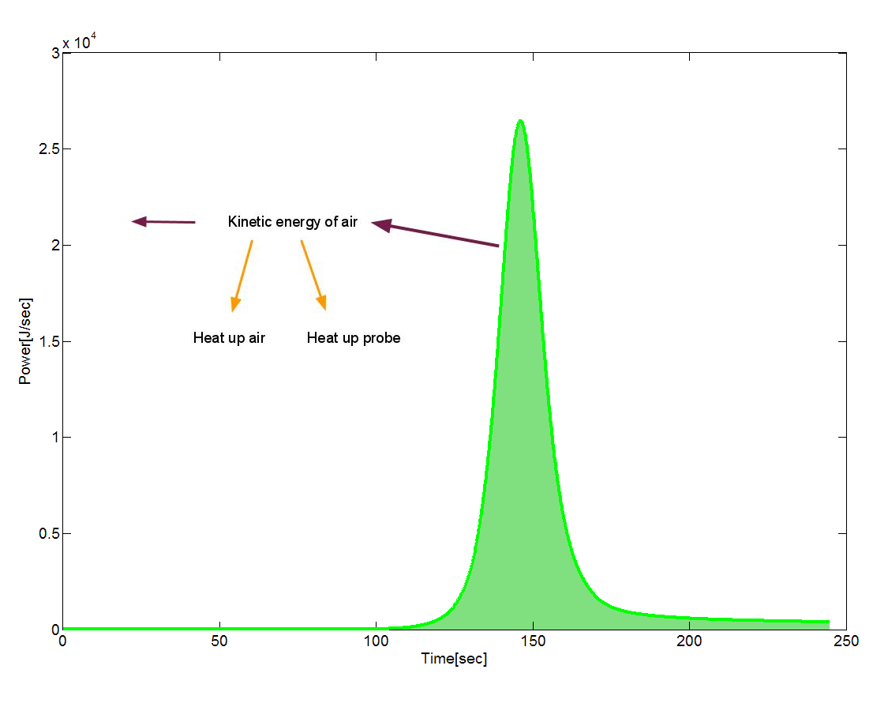
Rocket SAT
UNC Physics was involved with a project called Rocket SAT-X, an outreach program funded by the Colorado Space Grant Consortium (COSGC). This program challenged students to design and fabricate an experimental payload that was launched on a Terrier-Orion sounding rocket, provided and launched by NASA’s Wallops Flight Facility in Virginia. The rocket flight launched the payloads approximately 120km into space, where the rocket then shed its fairing, exposing the student payloads to the space environment (Figure 1).
University of Northern Colorado
Design Methods Material and Data Recovery
Reentry Experiment SAT-X
The mathematical model presents two design issues:
Heat buildup due to air friction may cause breakup or melting.
The capsule may not survive the extreme force of impact at splashdown
Unfortunately, accounting for one amplifies the other, i.e., reducing the drag decreases the total heat buildup yet increases the capsule’s impact velocity. Therefore, the capsule was machined from 6061 Aluminum (using an automated CNC mill) and reflected the design in Figure 2. Aluminum provided a strong, supportive material that was light and that could absorb large amounts of thermal energy.
Data may not be retrievable because of burn-up on reentry, destruction on impact, or inability to recover the capsule. To ensure data capture, a set of 900MHz XBee radio transceivers continuously transmitted information from the capsule to the ground via the base station on the rocket (Figure 6). Antennae were embedded within the tailfins (which were made of PCB) to maximize the capsule-rocket wireless connection.
M. Woods, A. Adamson, J. Aken, M. Honda, C. Kuhns, & R. Shiely
Advisors: C. Galovich, M. Semak, & R. Walch
Abstract
The University of Northern Colorado Reentry Experiment SAT-X (ReX) project was designed to shed light on the challenging process of atmospheric reentry. The experiment was conducted using a small reentry capsule, jettisoned at apogee from a sounding rocket. The flight tested the capability of the capsule as a platform for future reentry experiments.
Mission Introduction
“To provide a method for institutions to utilize a deployable and recoverable payload for future Rocket SAT-X missions. By providing this, we can greatly increase the amount of data recovered by eliminating the need to transmit restricted amounts of data to the ground.”
ReX aimed to characterize the process of reentry via data collected from a capsule ejected from a sounding rocket at apogee. Inertial data was used to reconstruct the actual trajectory, as well as to profile the drag force. In the absence of the actual data, a mathematical model (outlined in Theory and Scientific Concepts) was constructed to inform the initial capsule design. Data collected from the flight was used to optimize the model, thereby facilitating further refinement of the capsule design. By optimizing the payload design, fewer resources may be used in payload fabrication, saving time and money. Finally, this tested platform can be used by future reentry experiments, as the design and fabrication process have been refined by the ReX team.
Design Methods Reentry Capsule Shell & Base Station
Theory and Scientific Concepts
The analytical model estimates the force of impact and the effects of heat during reentry. It was used to refine the shape of the capsule (Figure 2) and to interpret the flight data.
The model requires a knowledge of the forces exerted on the reentry vehicle. The dominant force is air resistance. Assuming a purely vertical descent, the resultant acceleration due to air drag and gravity results in the following equation:
Using this equation, the capsule’s velocity versus altitude can be plotted. This is the blue curve in Figure 3.
Figure 3. Reentry vehicle dropped from 120km
The green curve describes the motion of a freely falling object. The red curve is the altitude-dependent terminal velocity. At higher altitudes, where there is virtually no drag, the object is effectively freely falling as indicated by the convergence of the blue and green curves.
At the point where the terminal velocity and free fall curves cross, the capsule experiences a significant change in velocity. The change is abrupt, as illustrated by the velocity and acceleration profiles in Figure 4. This phenomenon can be compared to that of an object hitting a “wall of atmosphere”. The “impact” causes the reentry object to experience a large impulse and heat buildup due to air friction. Both effects could prove hazardous to the capsule.
The curve in Figure 5 is generated by calculating the power as a function of time using the drag force and capsule’s velocity. The area under the curve is potentially the heat transferred to the capsule.
“Bomb” Model
Sphere Model
Apollo Capsule
Streamlined Model
Each of the above models was constructed and evaluated for: aerodynamic stability, self-orienting characteristics, structural integrity, internal storage space for electronics, and drag coefficient. The evaluation was carried out by conducting several short-range drop tests and using a CAD simulation and the mathematical model. With this, the streamline shaped model proved to be the most suitable candidate for an effective reentry vehicle.
Figure 2 shows the entire ReX payload. The capsule contains two electronics and sensor boards and radio antennae are embedded in the tail fins. A harness/lock holds the capsule in place until an external timing signal triggers the unlocking sequence. The capsule is then ejected by a spring loaded plunger. An HD camera is used to record the capsule launch. All of these subsystems are integrated on the rocket-mounted deck plate.
Figure 6. Functional Block Diagram
Results and Discussion
1.Launch
2.Ascent: Onboard electronics initialize
3.Apogee: Fairing deployment; ReX capsules deployed
4.Decent: ReX capsules collect reentry data; Data transmitted to rocket
5.Splashdown
2
Recovery of the ReX payload after mission termination and splashdown suggested that the capsule was ejected properly at apogee. Successful ejection was confirmed by the recovery of onboard video footage of the rocket body after fairing separation. The reentry capsule body has still not been recovered. Physical examination of the recovered rocket payload section showed that the payload's computer and electronics box did not survive the flight and was missing altogether. Evidence of scraps and buffs in the aluminum deck plate and on the aluminum container of the UW AstroX payload (located directly beneath the ReX payload) suggested that the computer box liberated itself from the rocket. This may have been caused by splashdown or the unexpectedly high temperatures experienced by the rocket during reentry.
Telemetry data collected and recorded by Wallops Flight Facility suggested that the ReX payload failed to collect any useful inertial data from any of the capsule's sensors. The telemetry log showed that the payload's umbilical to the capsule (designed to turn on the capsule computer and confirm capsule connectivity to the rocket) were operational until capsule separation. After ejection, the capsule's sensors were functional for only six seconds, after which time only intermittent signals were received
3
1
Reentry Capsule
Capsule Harness/Lock
Accelerator (Spring/Plunger)
“Go Pro” HD Camera Housing
Rocket-Mounted Deck Plate
1
2
3
4
5
3
2
1
4
5
Figure 2
1
2
Figure 4. Reentry vehicle dropped from 120km
Figure 5. Heat Energy of Reentry
Figure 1

